Slide 1

Classification of MRI imaging of ASD using deep learning methods
Submitters:
Nitzan Ezra
Lior Buzaglo
24-2-R-8
Supervisors:
Assoc. Prof. Miri Weiss-Cohen
Dr. Anat Dahan

Slide 2
The problem
What is Autism spectrum disorder (ASD)?
A brain-based disorder that involves social deficits and repetitive behaviors.
Traditionally diagnosed through behavioral assessments.
Motivation:
Early diagnosis improves social skills and communication in children with ASD and enhances quality of life for those affected.
Crucial for controlling and treating the disorder.
ASD affects one in 68 children in the United States.
Notes:
Autism spectrum disorder (ASD) is a brain-based disorder involves social deficits and repetitive behaviors. ASD is traditionally diagnosed through behavioral assessments.
its important because early diagnosis can improve the social skills and communication problems of children with ASD and enhance their quality of life. In USA ASD affects one in 68 children.

Slide 3
Today, ASD diagnosis is based on behavioral and developmental evaluations.
Our Goal:
Improve accuracy in detecting autism spectrum disorders.
Clinical Heterogeneity.
Genetic Diversity.
Diagnosis Based on Symptoms.
Notes:
Today there is no unequivocal way to detect ASD,
To ASD there is no single genetic marker for the diagnosis, Autism is caused by a combination of different genes, which can affect in various ways. Therefore, the diagnosis is made phenotypically (phenotype is The outward physical expression of a genetic trait). a given phenotype may arise from a diverse set of biochemical processes.
Autism encompasses a wide range of symptoms and severity levels. Individuals with autism can exhibit very different behaviors, communication abilities, and interests, making it challenging to establish uniform diagnostic criteria.
Therefore, diagnosis of autism by primarily behavioral symptoms and observations, rather than on objective tests such as blood tests or imaging, can lead to subjective assessments or differences in diagnosis between different doctors.
OUR goal is to improve the accuracy in detecting autism spectrum disorders.

Slide 4
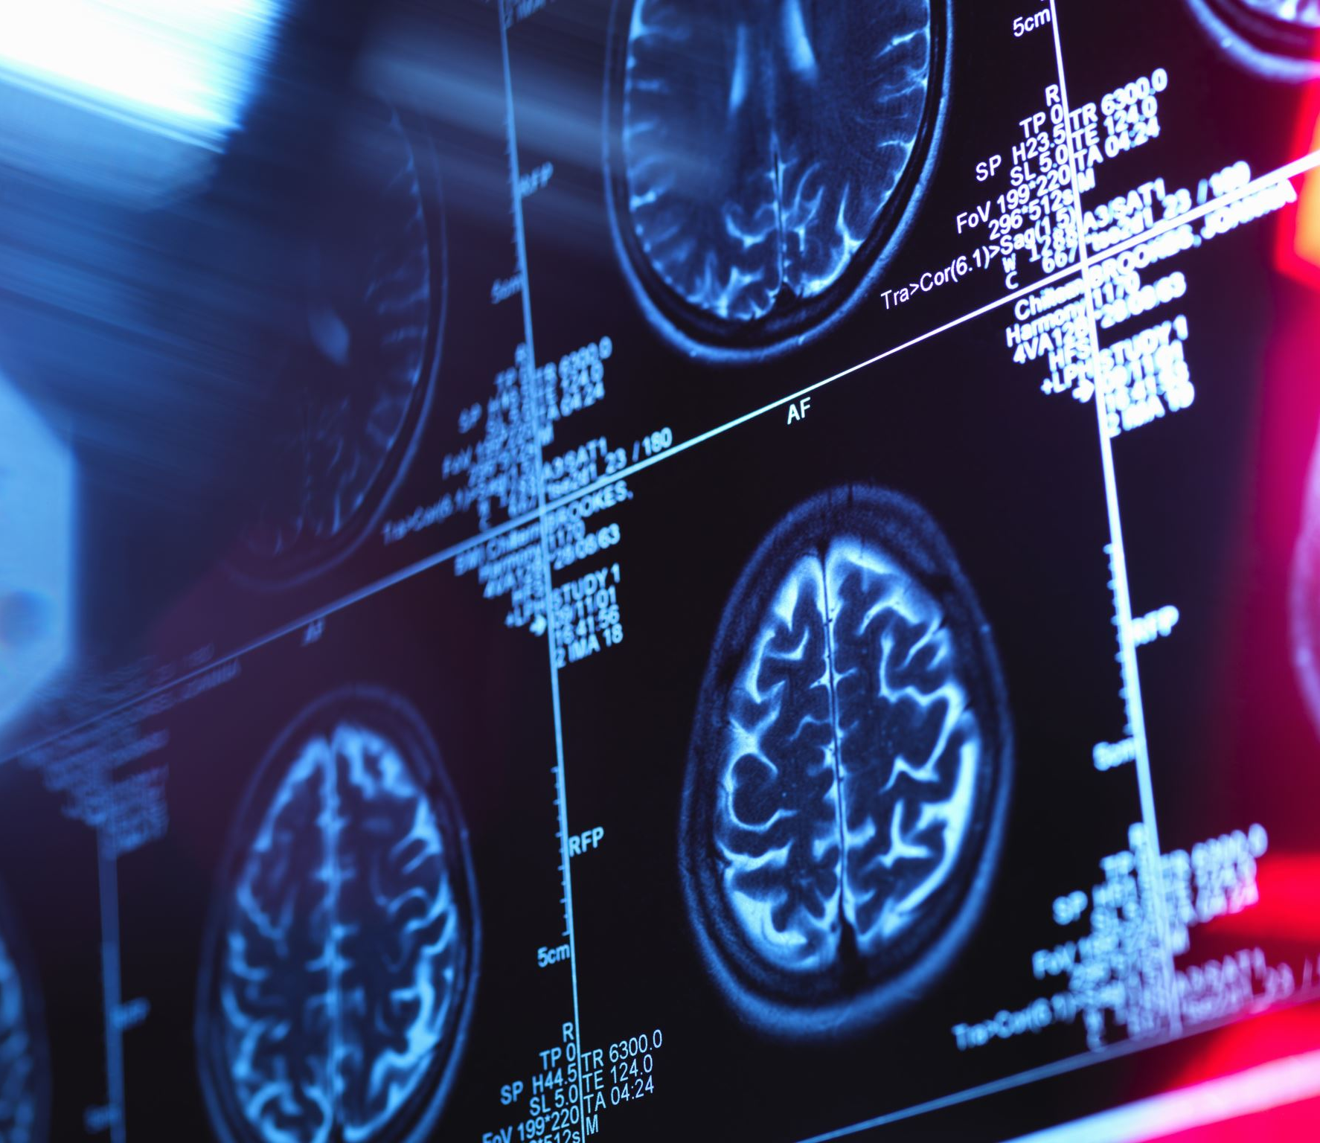
MRI
MRI, or Magnetic Resonance Imaging, is a medical imaging technique used to produce detailed images of the body's internal structures. It uses strong magnetic fields and radio waves to generate images of organs, tissues, and bones.
Types of MRI
Functional MRI (fMRI)
Structural MRI (sMRI)

Slide 5
Autism Brain Imaging Data Exchange (ABIDE) Dataset
36 sites worldwide.
2,226 datasets: 1,060 ASD, 1,166 controls.
Ages: 5 to 64 years.
Includes resting-state fMRI, structural MRI.
We will use anatomical MRI scans at 256x256 pixels.

Slide 6
Previous research
Identification of Autism Spectrum Disorder Using Deep Learning and the ABIDE Dataset
Accuracy Achieved: 70%
Methods Used: Denoising Autoencoders (DAEs), Multilayer Perceptron (MLP) with functional MRI

Slide 7
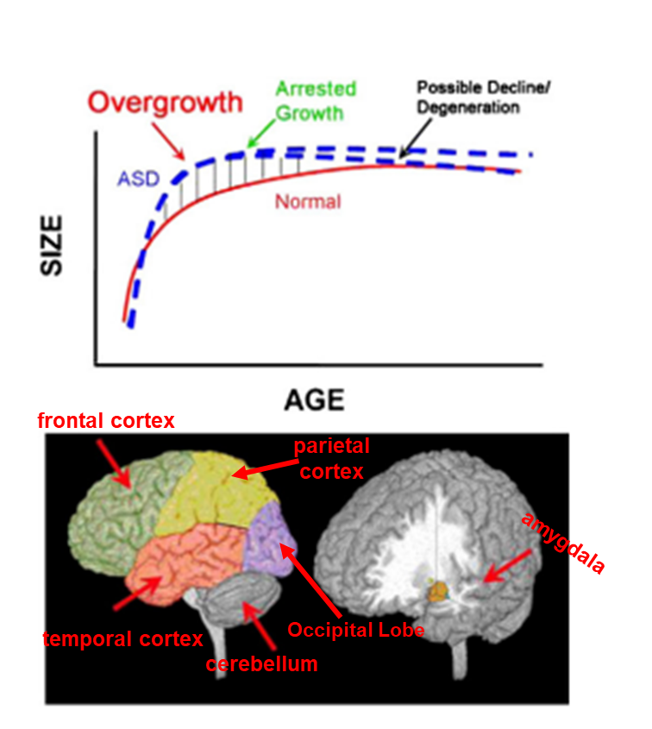
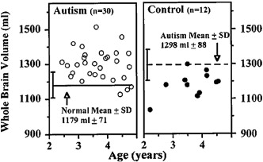
Findings
Normal Brain Size at Birth: The brain is a typical size, especially in the front and sides.
Early Childhood Growth: Total volume brain grows too much early on but becomes normal-sized by the teen years.
Irregulars cortical gray and white matter.

Slide 8
Suggested solution
We will use CNN-Inception v4 with transfer learning to classify the anatomical MRI images.
Our model will classify anatomical MRI scans, distinguishing ASD participants from control using brain imaging data from ABIDE and attempting to unveil the neural patterns that emerged from the classification.
Success Criteria: Achieve at least 70% accuracy.

Slide 9
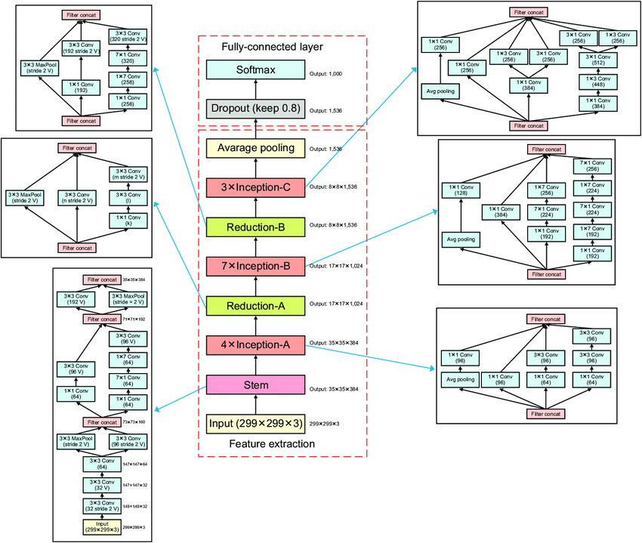
Inception-V4
Notes:
Inception-v4 is a type of convolutional neural network (CNN). Inception v4 designed for tasks like image classification and object detection.
Our input is the mri image padding its go through a stem,
Stem: The stem is used to preprocess the data before it enters the Inception module, is initial convolutional and pooling layers that process the input image, extracting low-level features such as edges, textures.
Inception layers applies multiple convolutional filters in parallel (1x1, 3x3, 5x5) to capture different feature scales, followed by concatenation. each layer build more general features from the previous layers features
Reduction blocks: are modules between the three Inception modules act as pooling layers , they using convolutions and pooling to reduce the spatial dimensions while preserving key features.
Average Pooling: A global average pooling layer that reduces the dimensionality by computing the average across each feature map.
Dropout: A regularization technique to prevent overfitting by randomly setting some units to zero during training.
Softmax: The final layer that generates the class probabilities for classification tasks.

Slide 10
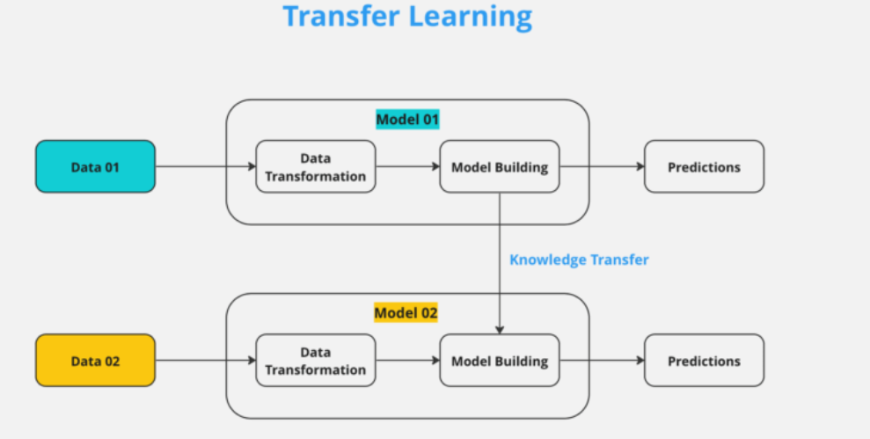
Transfer learning
A technique where a model trained for one task is reused for a related task.
Advantages:
Requires less data and computational resources.
Improves the efficiency and effectiveness of deep learning applications.
Notes:
Transfer learning is a machine learning technique where a model developed for one task is reused for a different, but related, task. It leverages the knowledge gained from solving one problem to improve performance on another, often requiring less data and computational resources.

Slide 11
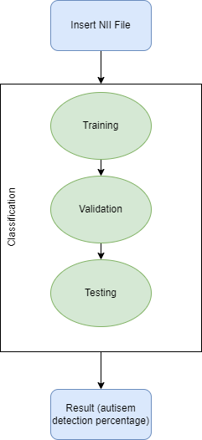
Model flow
Data Split: 80% Training , 15% Validation , 5% Testing
Hyperparameters:
Learning rates will be tested at 5e-4, 5e-5, and 5e-6. Epoch sizes range from 50 to 150.
The Batch Size 32 or 64.
The dropout rate of 0.2 to 0.5.
Notes:
Before starting the training process, we prepare the dataset.
The dataset includes MRI images labeled as either ASD or non-ASD.
The dataset is split to Training - 80%, the traning layer is Used to train the model.
Validation set 15%: Used during training to monitor the model’s performance and help prevent overfitting. The test set 5%: Used after training to evaluate the model’s final performance.
Images are padded to match the required input size (299x299 for Inception V4
Loading Inception V4 model pre-trained on ImageNet.
The early layers of the pre-trained model capture general features, which are useful for many tasks. Therefore, these layers are frozen during training to retain their pre-trained weights. Only the deeper layers will be trained to learn task-specific features.
The final layer will have 2 output units with a softmax activation function to output probabilities for the two classes.
Training:
Initially, only the new layers added to the model are trained, while the early layers from Inception V4 are frozen.
Validation:
Monitor validation performance after each epoch to check for signs of overfitting or underfitting.
Testing:
To evaluate the final performance, we will measure performance metrics such as accuracy, precision, recall, F1-score, and confusion matrix on the test set to assess how well the model generalizes to completely unseen data.
Once the model performs well on the training, we will fine-tune if necessary (canceling the freeze part or all of the model and continuing training with a smaller learning rate for better performance)

Slide 12
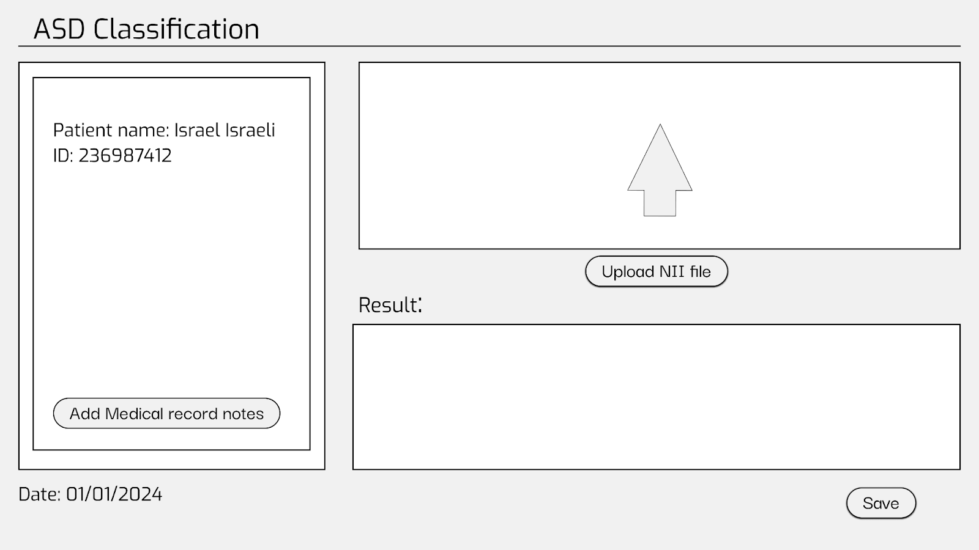
GUI – Main

Slide 13
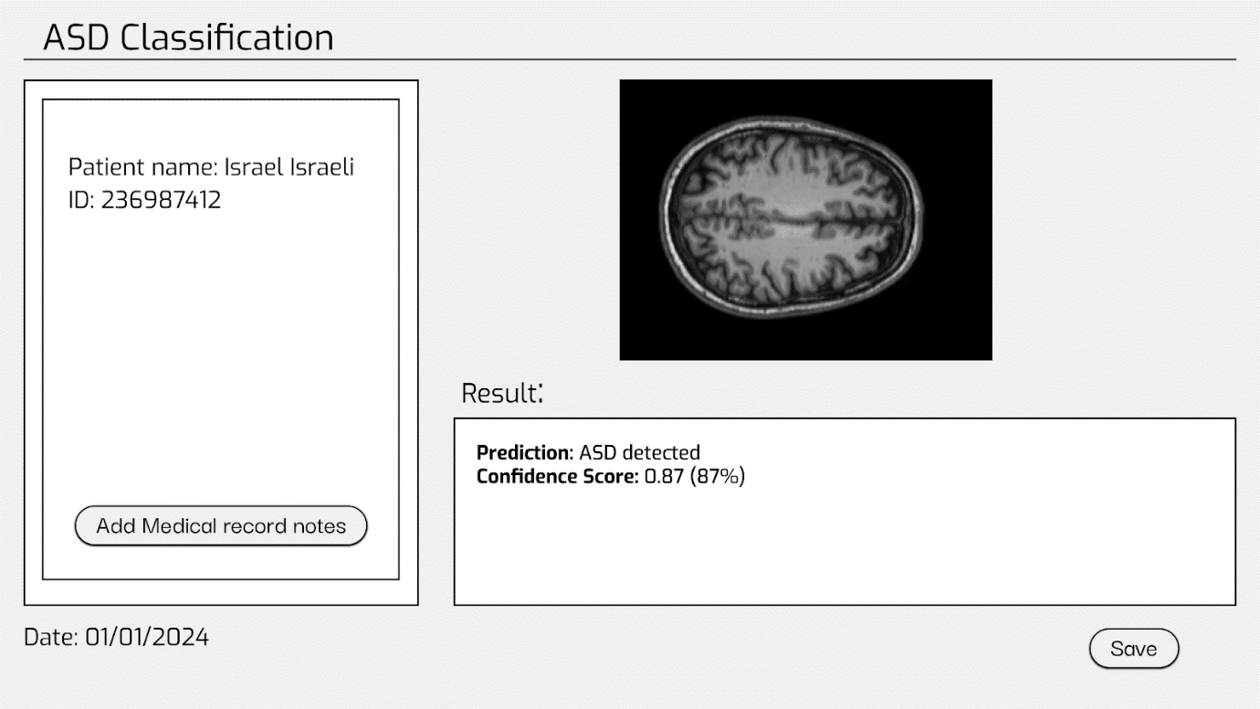
GUI – After loading the file

Slide 14
Test process
CASE # | Test explanation | Expected result
1 | Upload Nii file. | Sends the anatomical MRI scans as input to the model to start the enhancement process.
2 | Press->without upload anything. | Throw error: “Error! No file has been uploaded”.
3 | Insert wrong file type. | Throw error: “Error! The file type is not supported”.
4 | Insert empty file. | Throw error: “Error! The file is empty”.
5 | Press save (after uploading the file and receiving results) | Saves image to file system.
6 | Press save (before uploading the file and receiving results) | Throw error: “Please upload a file”
7 | Clicking on the "add medical record notes" button | Opening a window for entering information.

Slide 15

Thank you for listening!

